Slide 1
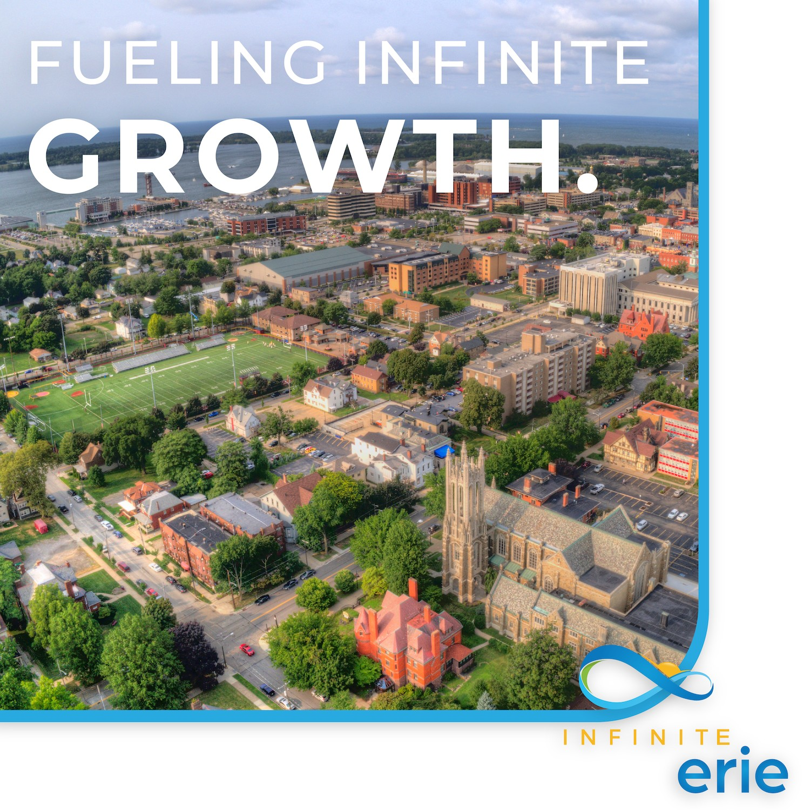
ECGRA Board Update
November 21, 2024

Slide 2
ABOUT INFINITE ERIE: How Does Infinite Erie Fuel Inclusive Growth?
Activate Project Portfolios
1
Convene Project Leads and Practitioners to Develop Solutions for Complex Projects identified in the Investment Playbook. There are four (4) Project Portfolios:
Industry Clusters and Infrastructure
Inclusive Entrepreneurship
Industry Clusters and Infrastructure
Anchor Investments in the Greater Core
Inclusive Entrepreneurship
Boost Local Capacity to Advance Projects
2
Infinite Erie Provides Technical Assistance and Capacity Building to Portfolio Project Leads and Individual Project Sponsors implementing the Investment Playbook and assists in advancing projects toward Investment Readiness
Discovery & Problem Solving
Project
Development
Securing Investment
Implementation
Organizing and Capacity Building

Slide 3
Putting Plans Into Action
Infinite Erie supports playbook projects at every stage of the project development pipeline
Discovery and Problem Solving
Project Development
Securing Investment
Implementation
Convene Practitioners and Subject-Matter Experts to Develop Strategies of Excellence to Solve Complex Problems
Provide Project Development Technical Assistance to Project Sponsors to move projects toward investment readiness
Provide Project Sponsors with Recommendations of Potential Funding Opportunities
Celebrate the Success of the Project Sponsor
and
Evaluate and Measure the Impact of the Project
and
“Community Accelerator Model”
and
Inventory and Evaluate Projects for Investment Readiness and Impact Alignment
Advocate on behalf of projects

Slide 4
INVESTMENT READINESS: Project Advancement Through Technical Assistance
+ Project Development
+ Finance Coaching
+ Community Outreach
+ Planning
+ Grant / Funding
Infinite Erie Technical Assistance
Project Concept
Investment Ready Project
“Infinite Erie Provides Technical Assistance and Capacity Building to Portfolio Leads and Individual Project Sponsors implementing the Investment Playbook.”

Slide 5
Measuring Success
Infinite Erie Team Accountability
Total Funding Secured:
Total Number of Projects Advancing a Stage Toward Investment Readiness:
Percent of Projects serving residents in ARC Economically Distressed or Justice 40 Census Tracts:
$41.9M
19/36
69.4%

Slide 6
FUNDING SNAPSHOT: Dollars Secured as a Result of Infinite Erie Technical Assistance
Sources:
ECF, EIG, ECGRA, City of Erie
Sources:
RACP, DCED NAP, PHFA, DCED Multimodal
Sources:
HUD, ARC Power, ARC Area Development, Federal Approps.

Slide 7
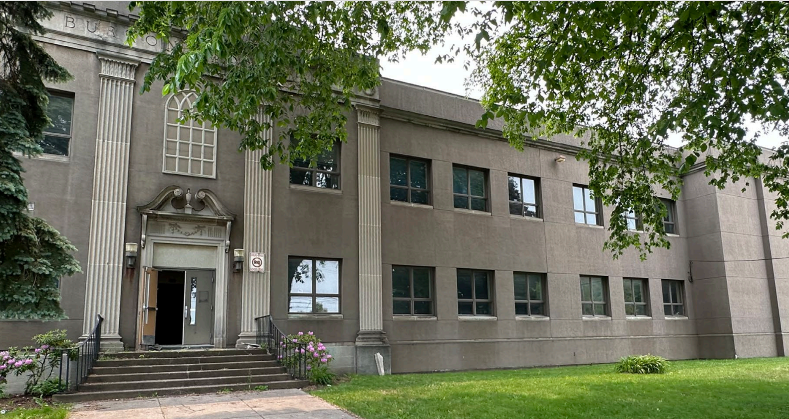
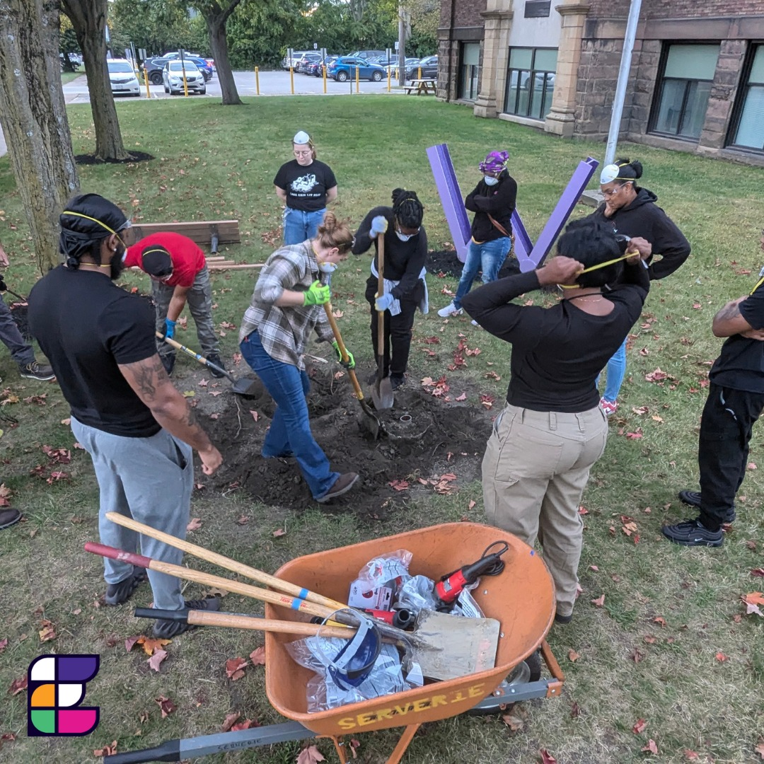
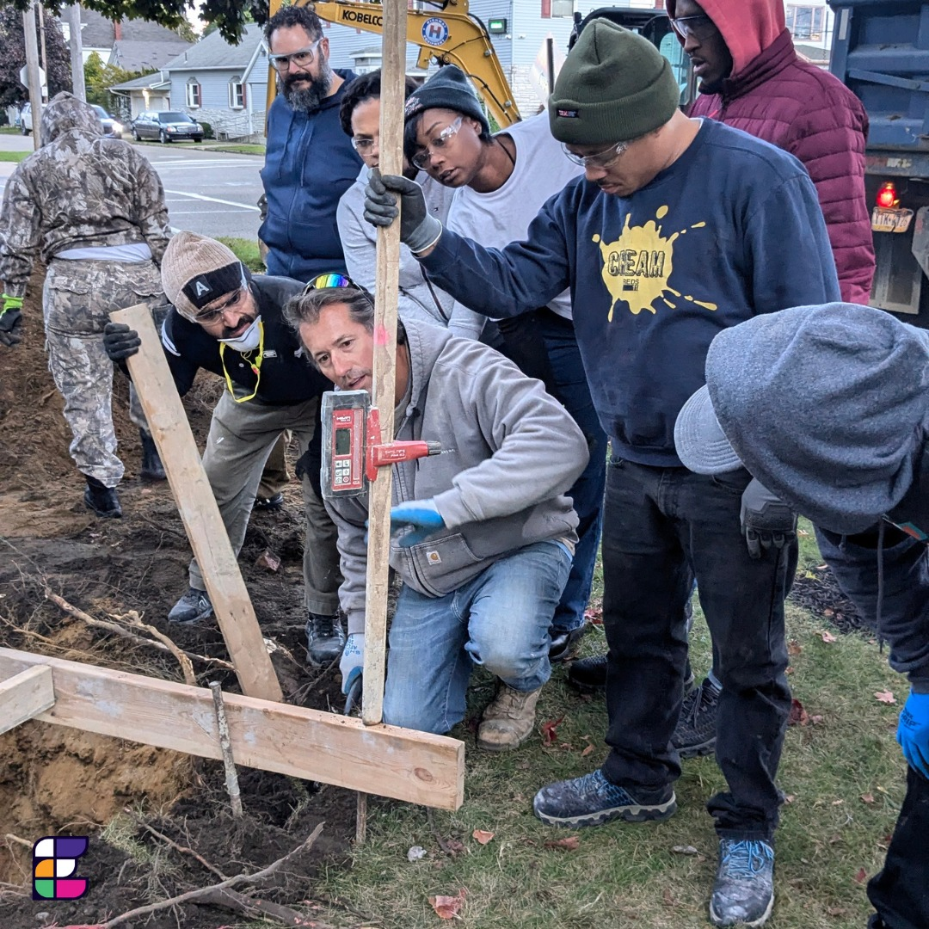
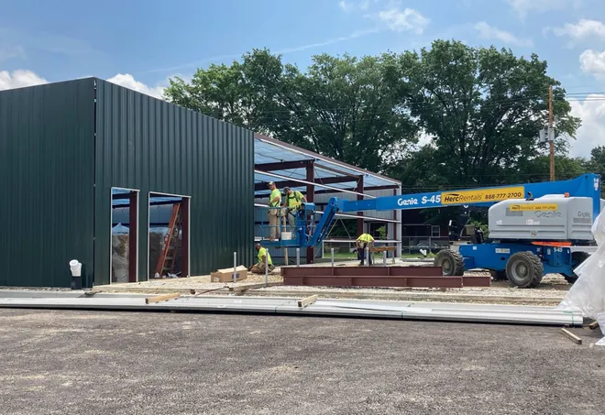
Collaboration in Action
GrowErie at Savocchio Opportunity Park
ECAT/BUILD Construction Trades Training Program Expansion
Burton School Revitalization
Inclusive Entrepreneurship Portfolio

Slide 8
What’s Next…
Reconvene Stakeholders in Q1 2025
Set goals/priorities through 2026
Formalize Prioritization and Portfolio Processes
Build Infinite Erie Capacity

Slide 9
Continuing Partnership with ECGRA…
Operations Support
$300,000
($150,000/year through 2026)
Matches ECF Commitment to Operations
Governance Support
Expand Board of Managers to add Dr. Perry Wood, ECGRA Executive Director
Current BOM includes:
Karen Bilowith, President ECF
Tim NeCastro/Christy Blashock, Erie Insurance
ERCGP – (vacant seat)

Slide 10
THANK YOU!

