Slide 1
Build a Better Future, Transformative Grant Program Erie County Public Library
-
Nov. 21, 2024

Slide 2
ERIE COUNTY
PUBLIC LIBRARY BEEHIVE JANUARY 2024 – NOVEMBER 2024
>170
Idea Lab Classes Held
147
Attendees Served
(Entrepreneur Programs)
22
Entrepreneur Programs Held
306
Unique users to the
Idea Lab
NWPA Innovation Beehive Network — The Outcomes

Slide 3
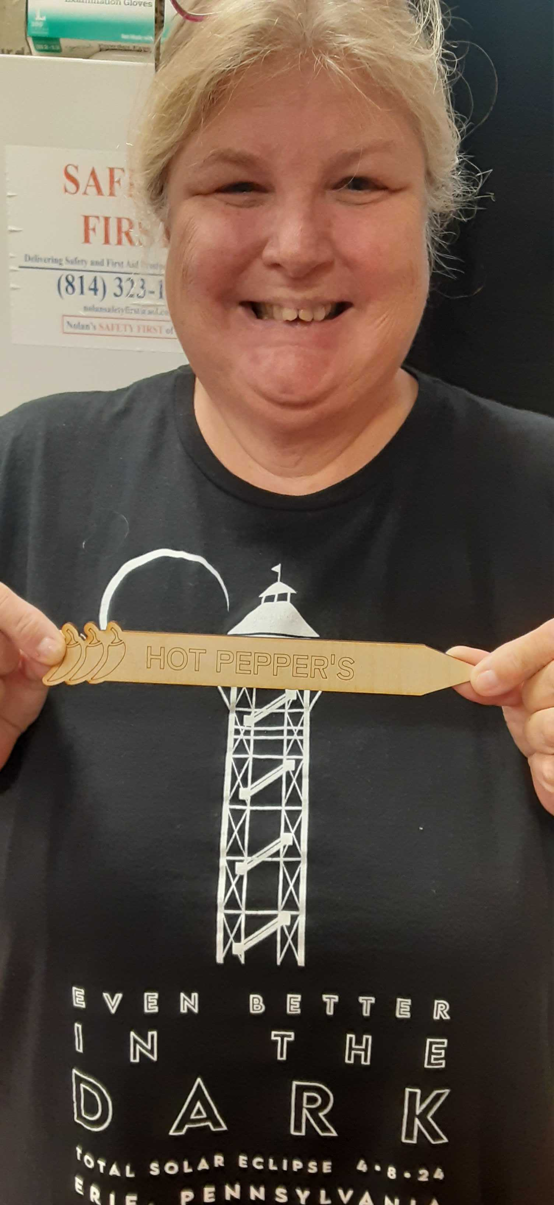
Additional Results/Outcomes
— Glowforge and Aura usage went up in 2024 and more people can laser cut/engrave because of the new equipment.
— 33 Erie Makes programs, up from 22 in 2023.
RESULTS/OUTCOMES

Slide 4
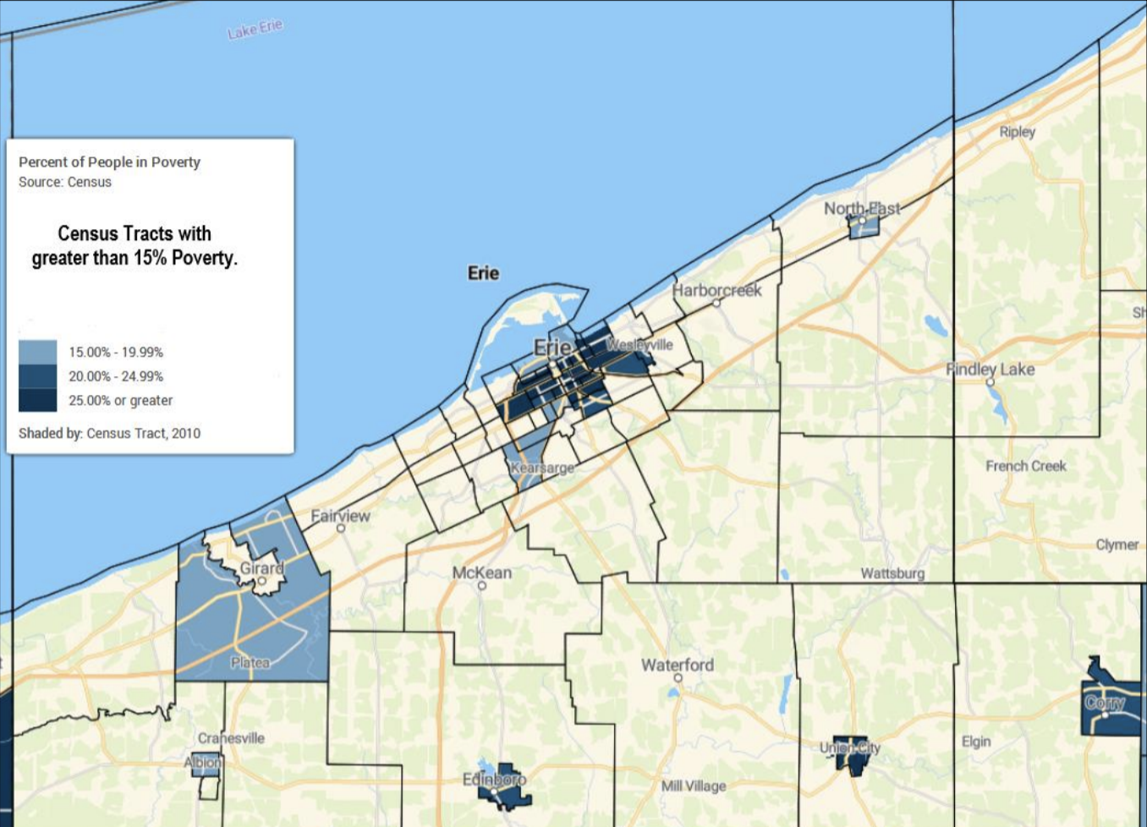
Initiative Highlight
-
Increased Unrealized Entrepreneur Programs
— According to patron feedback, Erie has wonderful opportunities for entrepreneurs that grew up talking business jargon around the dinner table, but not for patrons just starting out or without this background.
— ECPL fills this gap with its Unrealized Entrepreneur programs.
— Went from 18 to 22 programs.
— Will continue to increase in 2025.
— Looking into Entrepreneur-in-Residence program.
Source: Building a Better Future, Grant Guidelines
INITIATIVES

Slide 5
Thank you
-
Please reach out with any further questions.
Beehive
Rachel Stevenson
Business Librarian
rstevenson@eriecountypa.gov
814.451.6918
Beehive
Jess Reed
Emerging Technologies Librarian
jreed@eriecountypa.gov
814.451.7311
Erie County Public Library
Jessica Spitulski
Executive Director
jspitulski@eriecountypa.gov
814.451.6911
CONCLUSION

Slide 6
Build a Better Future, Transformative Grant Program Gannon Beehive
-
Nov. 21, 2024

Slide 7
GANNON BEEHIVE JANUARY 2024 – NOVEMBER 2024
>81
Businesses Served
(Already operational)
40
Entrepreneurs Served
(No businesses entity)
>25
Students Engaged
4
High School Students
NWPA Innovation Beehive Network — The Outcomes

Slide 8
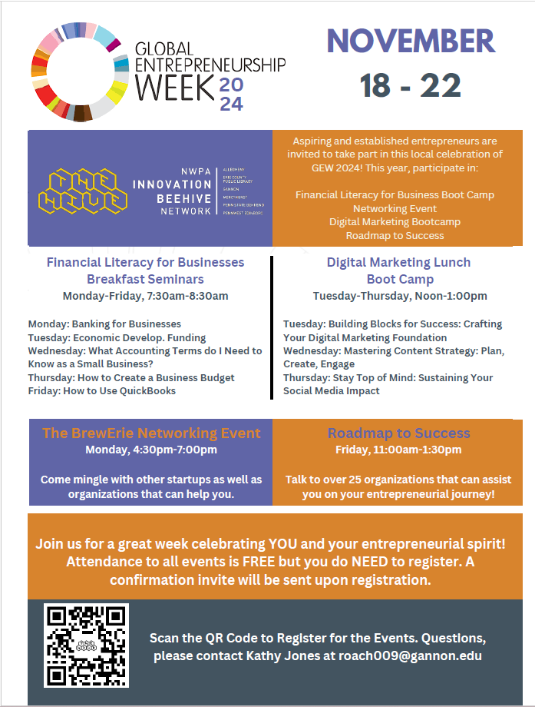
Additional Results/Outcomes
-
To impact Erie’s second largest race.
— In 2025, Gannon University’s black population served is at 23%.
— Since 2021, our Beehive has exceeded Erie’s 8% black population ratio.
— The Gannon “EcoSystem” has international students in the Beehive, a diverse Erie Technology Board, and over 130 students employed while in school gaining real world experience starting with ECGRA’s support.
RESULTS/OUTCOMES

Slide 9
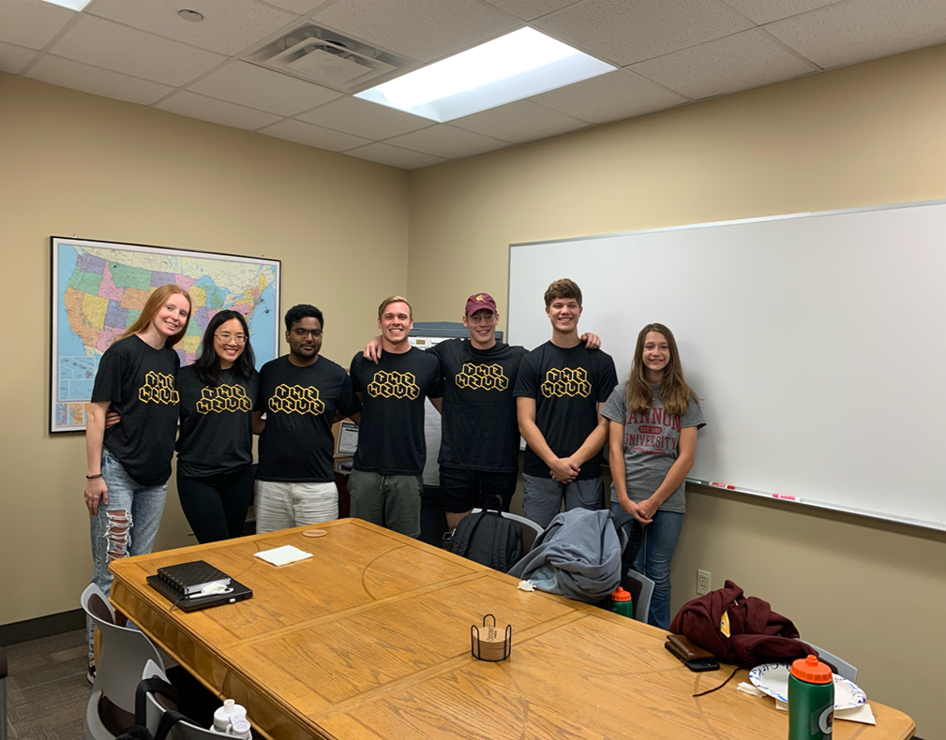
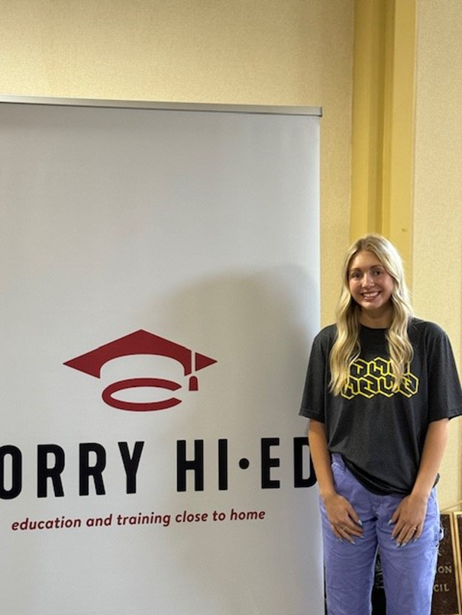
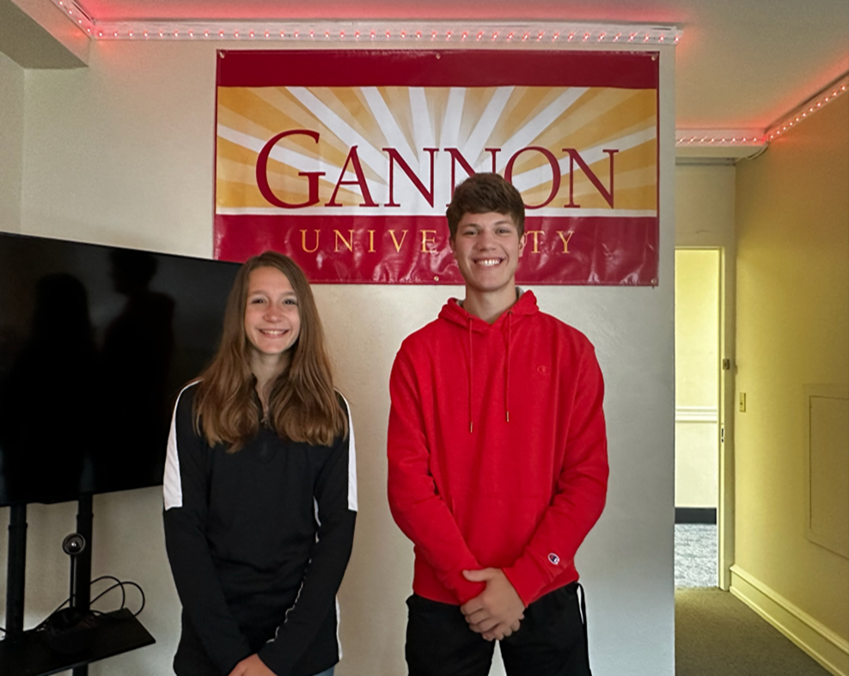
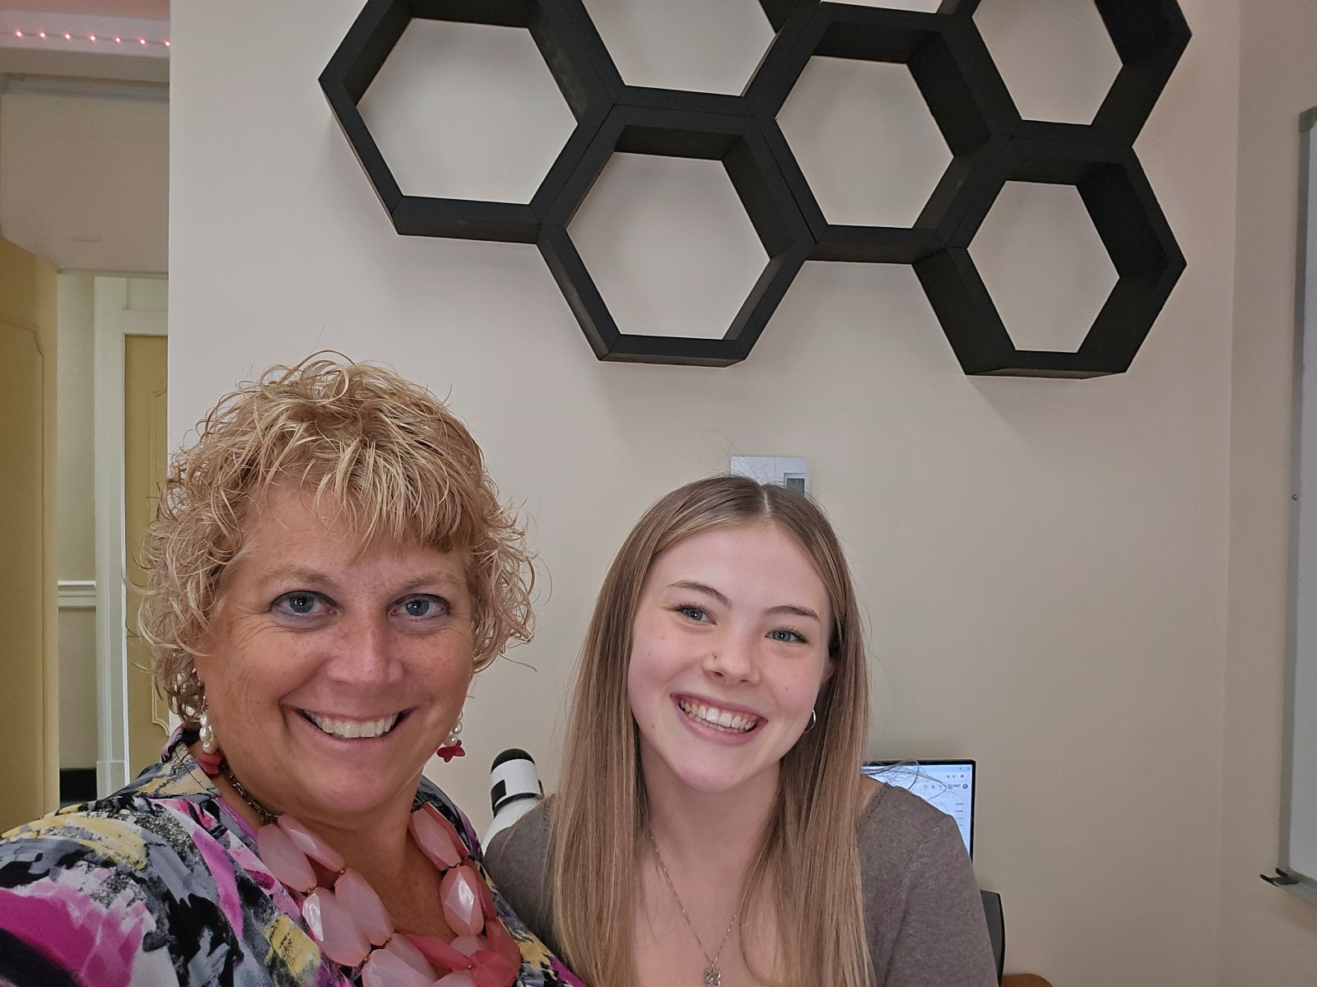
Initiative Highlight
-
EXPANDING: underrepresented communities receiving career exposures through Gannon University’s Beehive.
Fast Facts:
— Fall 2023: Corry High School starts the new Gannon University Beehive era of worker.
— Spring 2024: Union City High School joins the expanded labor movement.
— Spring 2024: A funding proposal has been submitted to expand this effort across five more high schools.
Corry High School
Union City High School
INITIATIVE

Slide 10
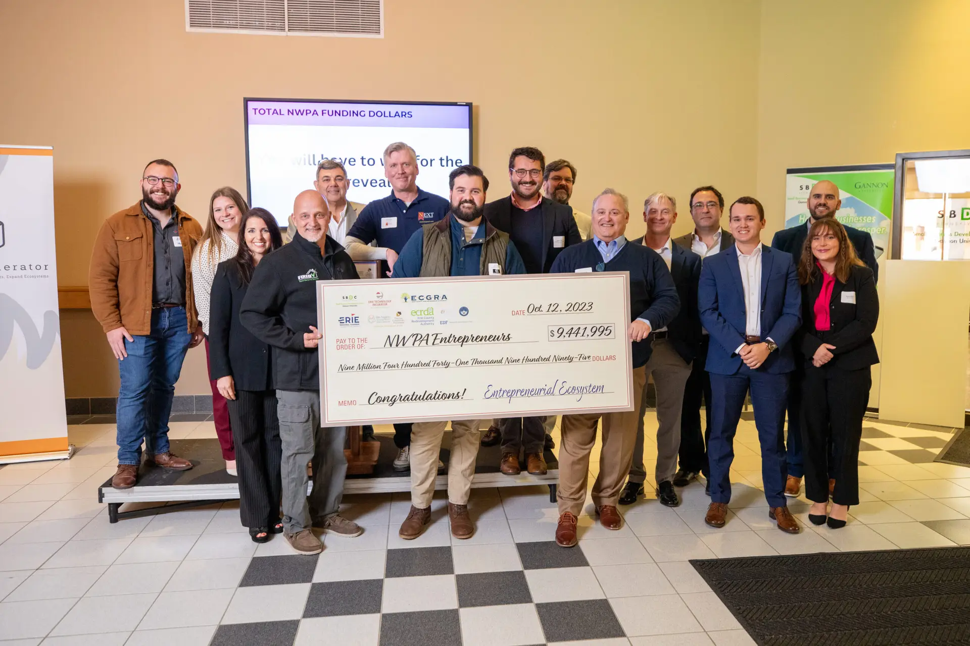
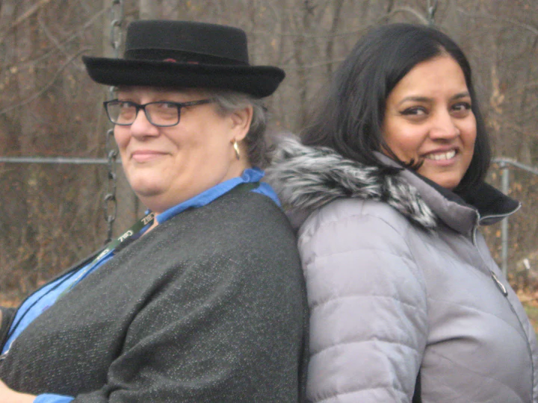
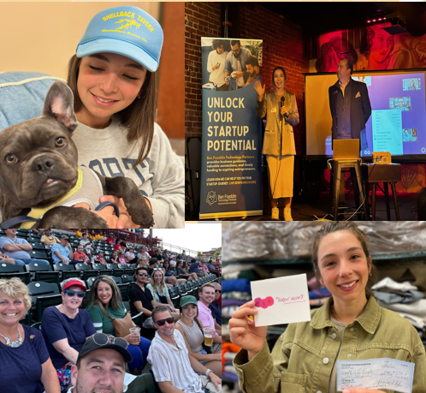
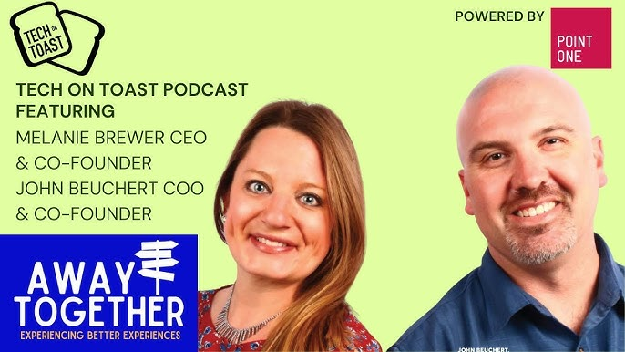
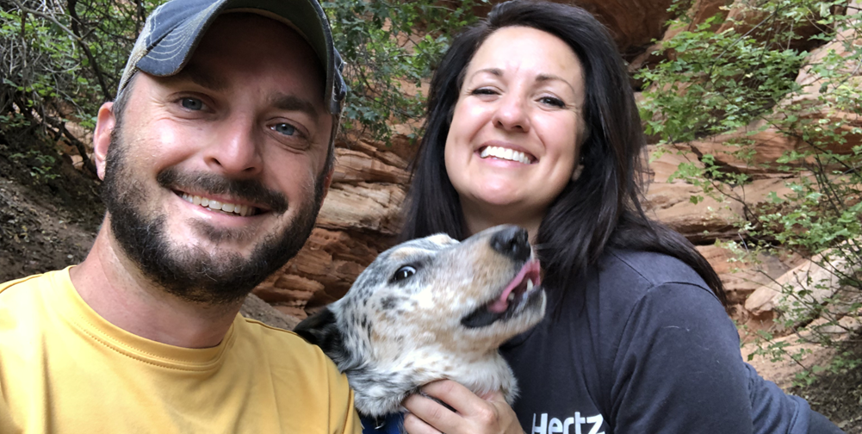
Additional Results/Outcomes
-
Investment in these women-owned companies go right back into Erie.
Fast Facts:
— Gannon Beehive’s first year obtained a 16% female startup participation rate.
— 2024 Gannon Beehive has a 53% female participation rate.
— We are on pace to have the busiest year in our history.
RESULTS/OUTCOMES

Slide 11
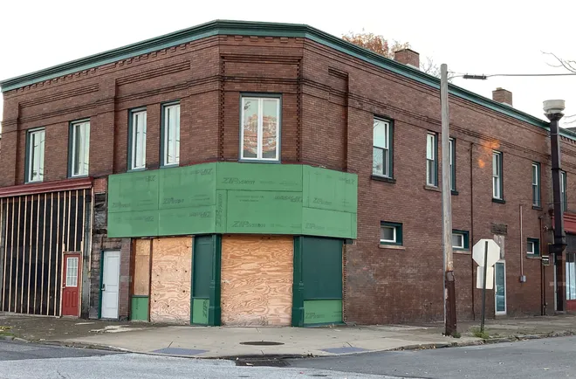
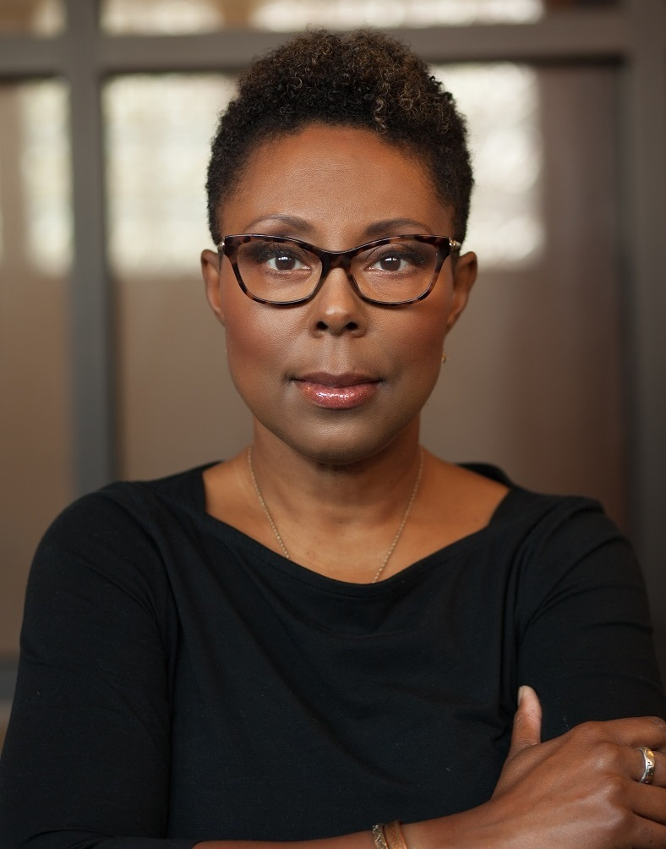
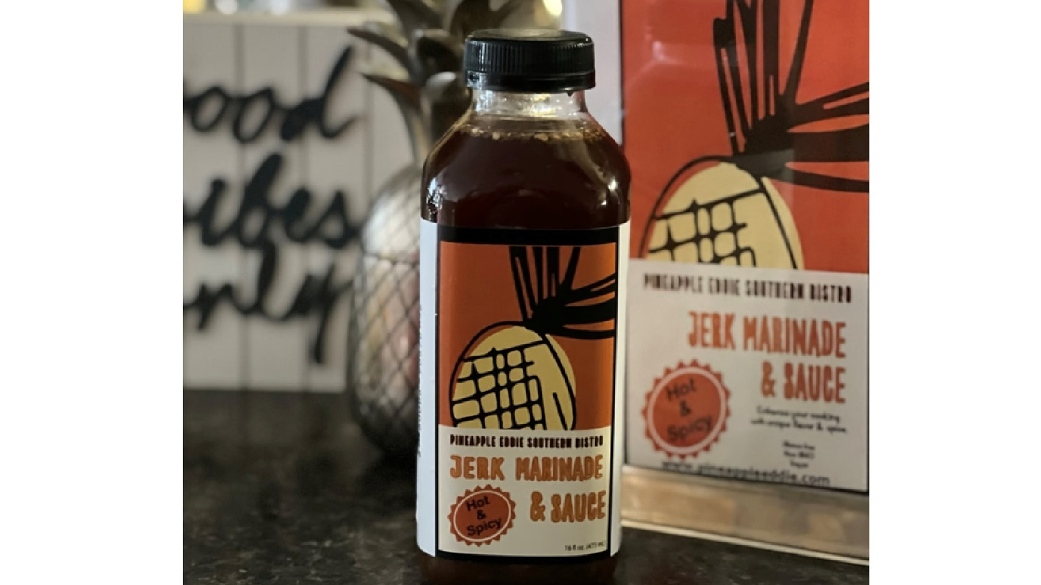
Karen Thomas, Inner City Market
— ETI Board member, turned second time business owner: 8Fronds LLC., and now Market Entrepreneur (A Force For Good).
— Successful business owner for 15 years in Erie’s West Bayfront.
— Received Gannon University Beehive support for 8Fronds LLC.
— Chose to depart from Pineapple Eddies, focusing on a new business and to funnel that work into the West Bayfront to address the fresh food desert in that community.
— A Crowd Funding Friendly Analysis (CFFA) supported 8Fronds and customized supports in continuation of a business that will be on the shelves at a new market spending just under a million dollars at 8th and Walnut Street.
— Erie County Gaming Revenue Authority funded research insights to inform Karen’s business development decision, creating jobs, reducing blight, while addressing healthy food deficits in Erie, Pennsylvania.
Source: Building a Better Future, Grant Guidelines
RESULTS/OUTCOMES

Slide 12
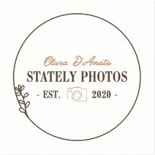
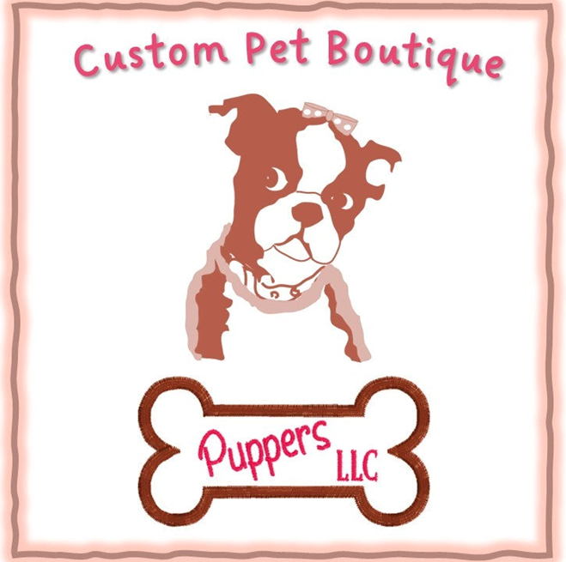
CLIENTS

Slide 13
Thank you
-
Please reach out with any further questions.
Gannon University Beehive
Brad Gleason
Director of Entrepreneurial Operations
Gleason006@gannon.edu 814-572-1817
Gannon University Beehive
Kathy Jones
ETI/Beehive Manager
Roach009@gannon.edu 814-490-4240
CONCLUSION

Slide 14
Build a Better Future, Transformative Grant Program Mercyhurst Beehive
-
Nov. 21, 2024

Slide 15
Mercyhurst University
Innovation Entente Lab (IEL)
________________________
Providing Clients With Market Analysis And Competitive Business Intelligence Strategies
Services include market analysis, competitive business intelligence, funding opportunities research, social media market analysis, industry best practices, cyber security, data collection & manipulation.
Mercyhurst University’s Beehive IEL team is located in a state-of-the-art innovation and production Lab on the University’s main campus.
INTRODUCTION

Slide 16
MERCYHURST UNIVERSITY
INNOVATION ENTENTE LAB "BEEHIVE" Fall 2023 – Fall 2024
26
Businesses Served
(Already operational)
30
Entrepreneurs Served
(No businesses entity)
>50
Students Engaged
15+
Events Attended
NWPA Innovation Beehive Network — The Outcomes

Slide 17
New Initiatives Cyber Security Program: Free cybersecurity advice to small businesses, helping them identify and address potential threats to their digital assets. It provides tailored recommendations on best practices, risk management, and affordable tools to improve security, ensuring businesses stay protected against cyber-attacks. Geospatial Analysis Program: In the IEL we can collect, analyze, and display geographic data for clients. A few use cases include demographic analysis, zoning, and property research. For Fall 2024, 90% of our projects provide geospatial analysis for clients. | New Tools Policy Map: Online tool that provides government, healthcare, non-profit, and academic organizations with easy access to exclusive public data on U.S. communities. Policy Map enables data-driven decisions on topics like health, housing, employment, income, demographics, and more. Maptive: Transforms spreadsheets into custom Google Maps in short order. Allowing analyst to quickly disseminate and visualize geospatial data for clients.
Generative AI Vizru ROVER: ROVER enables the IEL to analyze public and private data with exceptional insight and stringent security, which enables the IEL to provide unmatched competitive intelligence solutions to its clients. Further, by exposing IEL students to GenAI, we are fostering innovation and expertise within the realm of artificial intelligence, which is inherently the future of their world. | Average Personnel, Fall 23-Fall 24 Creating Jobs and Providing Real World Experience for Students Executive Director: 1 Director: 1 Graduate Students: 1 Undergraduates: 20 Freshmen Shadows: 2 *Graduate Student serves as the Student Lab Director
INITIATIVES

Slide 18
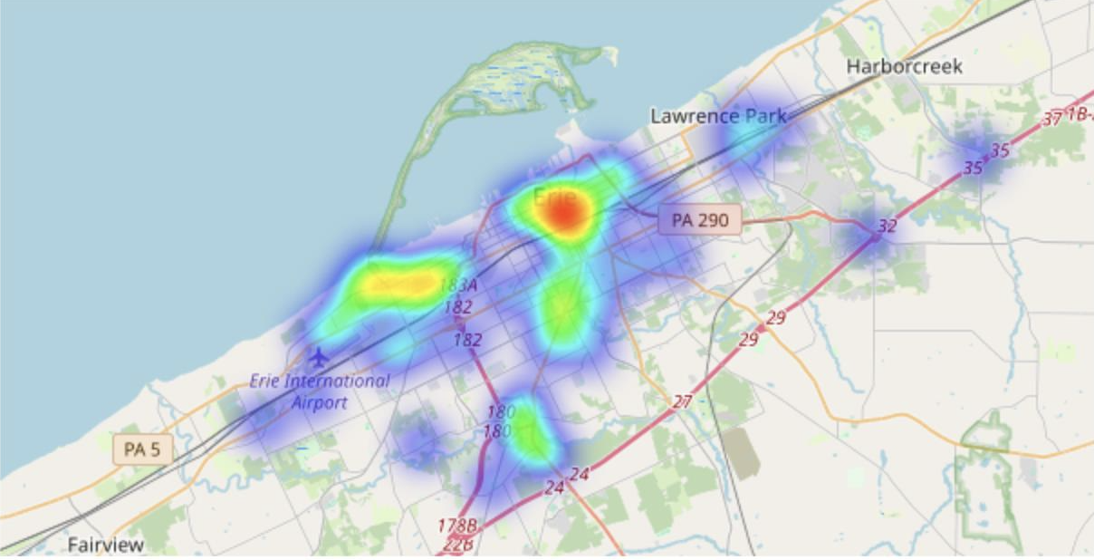
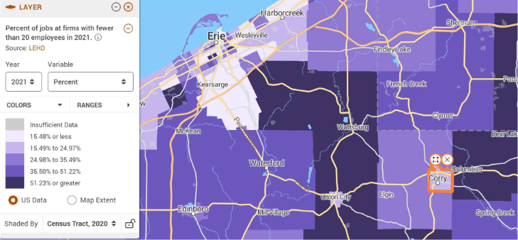
CoinArk LLC:
CoinArk LLC is a repeat client to the IEL Beehive and they are a pair of entrepreneurs who are creating safe and easy access to cryptocurrency in the Erie area. CoinArk came back to the IEL to have a Geospatial Analysis completed of the Erie area to learn the best location to place a new Bitcoin ATM. We were able to identify multiple locations in the Erie area where CoinArk could place a new ATM and be successful. This analysis was based on corroborating demographic data with industry research on who is most likely to be purchasing crypto currency.
Savory Truffle
Savory Truffle is an Artisanal Chocolate Business and Co-op located in Corry, PA. We are tasked with providing Savory Truffle with possible locations in which they could look for businesses to partner with for their co-op. To complete this, we were able to leverage one of our new tools: PolicyMap. Data was collected on the density of local businesses and how many individuals they employ, which was then translated into the following map by PolicyMap. Our analysis suggests it is likely that a business with fewer employees is an indicator of a developing venture.
Erie ATM Placement Density Heat Map, Maptive.
Percent of jobs at firms with fewer than 20 employees, Policy Map.
RESULTS/OUTCOMES

Slide 19
Thank you
-
Please reach out with any further questions.
Innovation Entente Lab
Brian Fuller
Executive Director
bfuller@mercyhurst.edu
Innovation Entente Lab
Nimalan Paul
Director npaul@mercyhurst.edu
Innovation Entente Lab
Zack Prisk
Student Director
zprisk53@lakers.mercyhurst.edu
CONCLUSION

Slide 20
Build a Better Future, Transformative Grant Program PennWest Edinboro Beehive
-
Nov. 21, 2024

Slide 21
PENNWEST EDINBORO BEEHIVE JULY 2023– NOVEMBER 2024
70
Businesses Served
(Already operational)
2
Entrepreneurs Served
(No businesses entity)
>40
Students Engaged (approximate)
>4,800
Student work hours provided to clients.
NWPA Innovation Beehive Network — The Outcomes

Slide 22
Additional Results/Outcomes
-
Freelancer In Residence program began in Fall 2024.
— Sara Garrity is first freelancer in this program (Sara Created LLC).
— Earning $4,000 through program and is serving Beehive clients (no cost to clients).
— Works in design/branding role for local university; is building small business as additional revenue stream.
— Previously went through ErieMade program to start/refine business, now gets this infusion of clients and capital.
— We’re currently hiring for spring 2025.
Additional Results/Outcomes
-
Consulting hours taking place at ECAT.
— Promised and delivering in-person consulting hours for Erie residents, based out of a partnership with Erie Center for Arts and Technology (650 East Ave Suite 120, Erie, PA 16503).
— 5 have taken advantage of service in fall 2024, with 1 already transitioning to Beehive client in Spring 2025.
-
Advertising
— Have used Facebook/Google ads, but all client loads are full, with many sites having backlog.
RESULTS/OUTCOMES

Slide 23
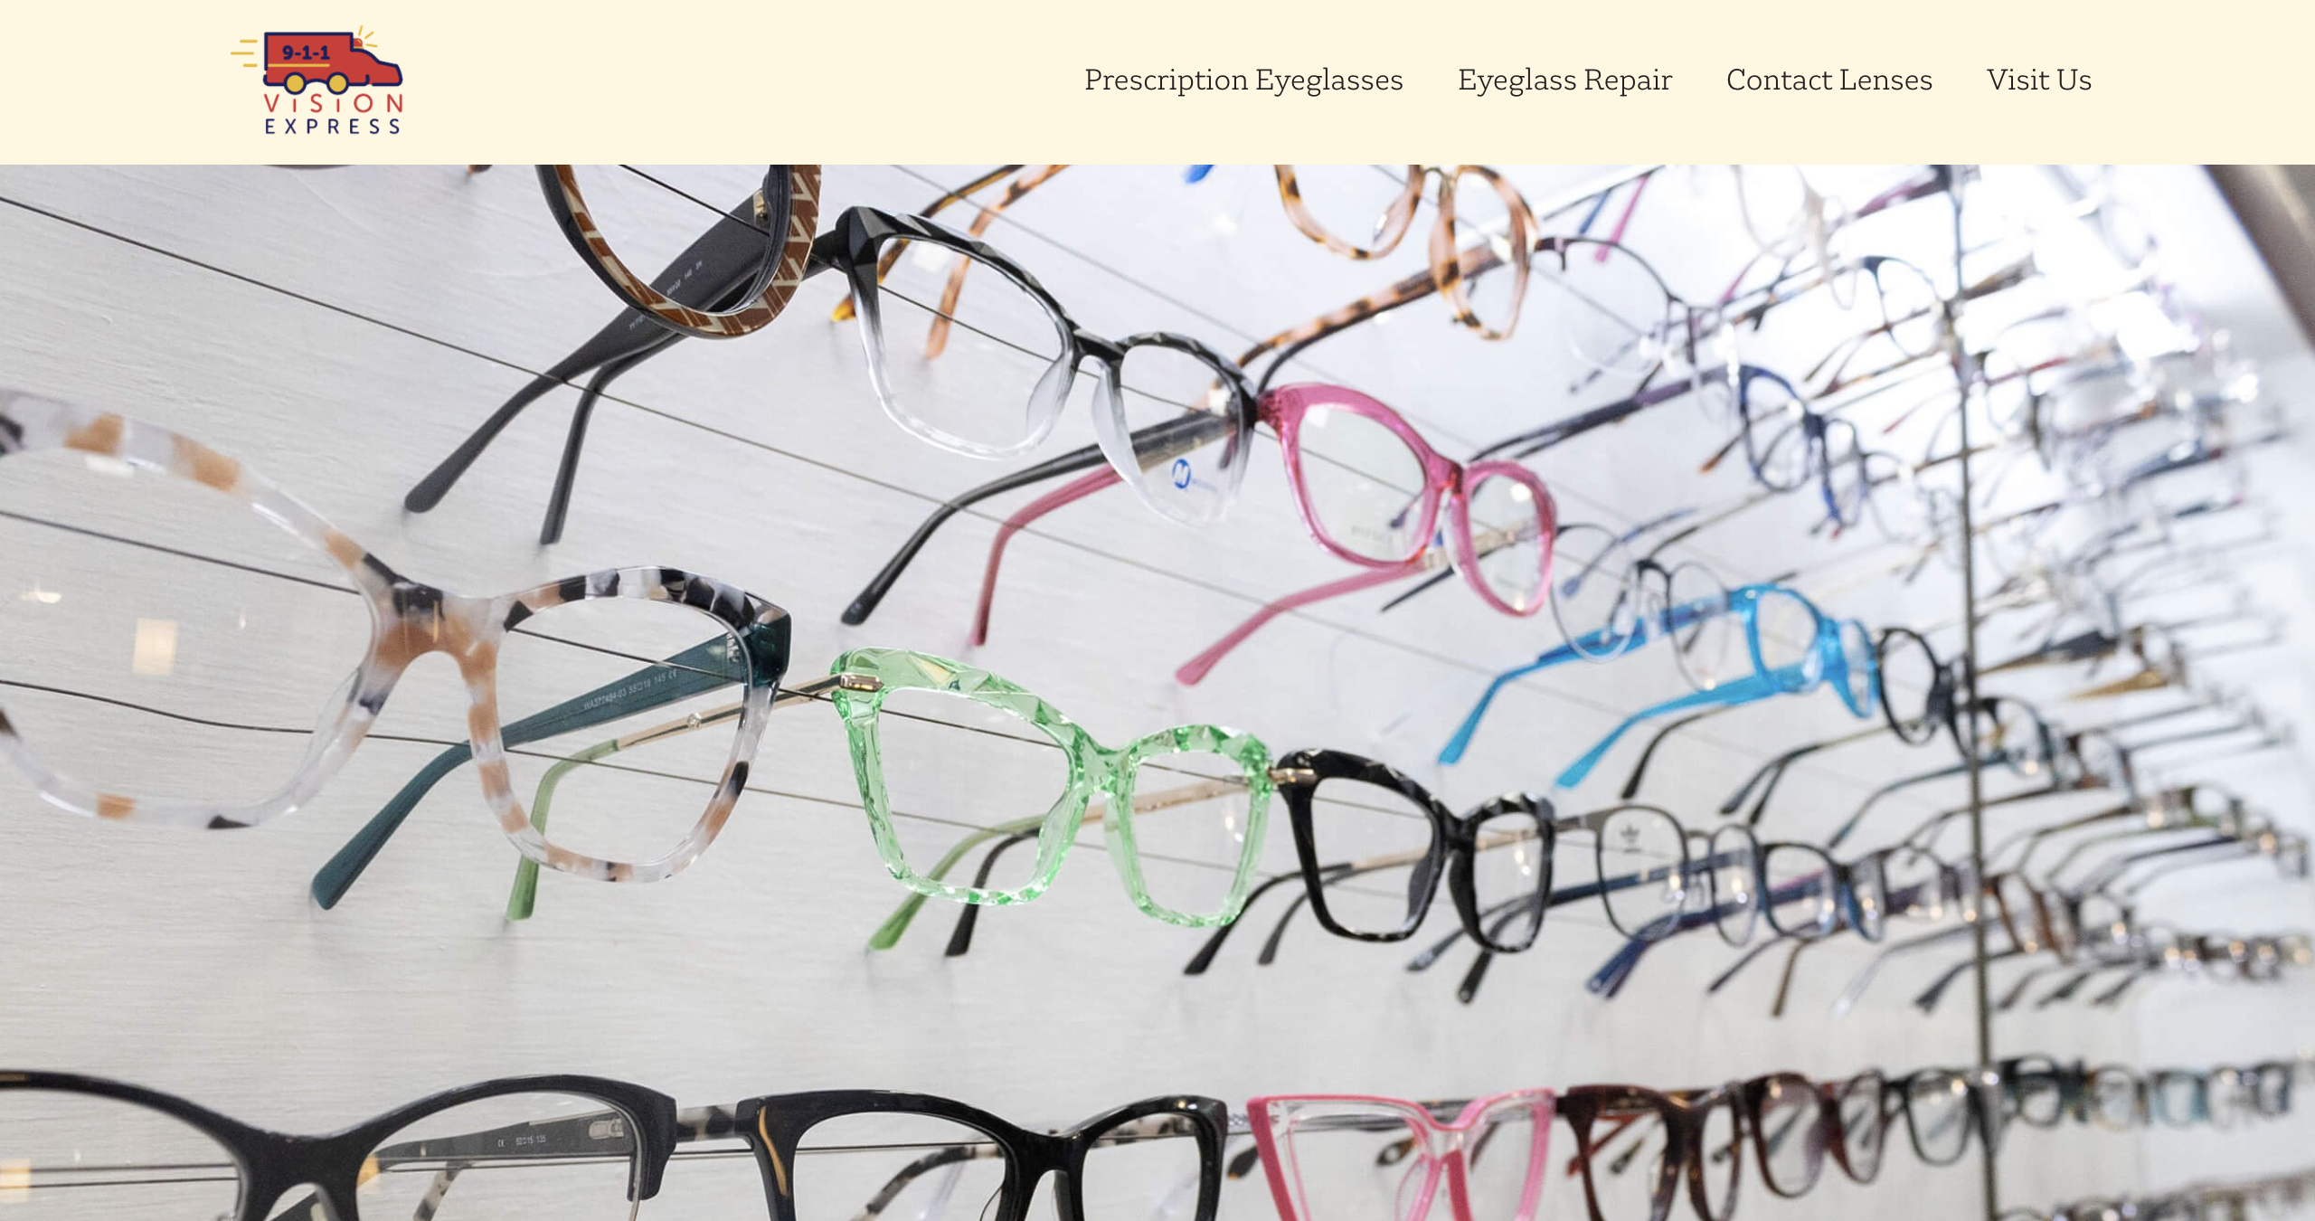
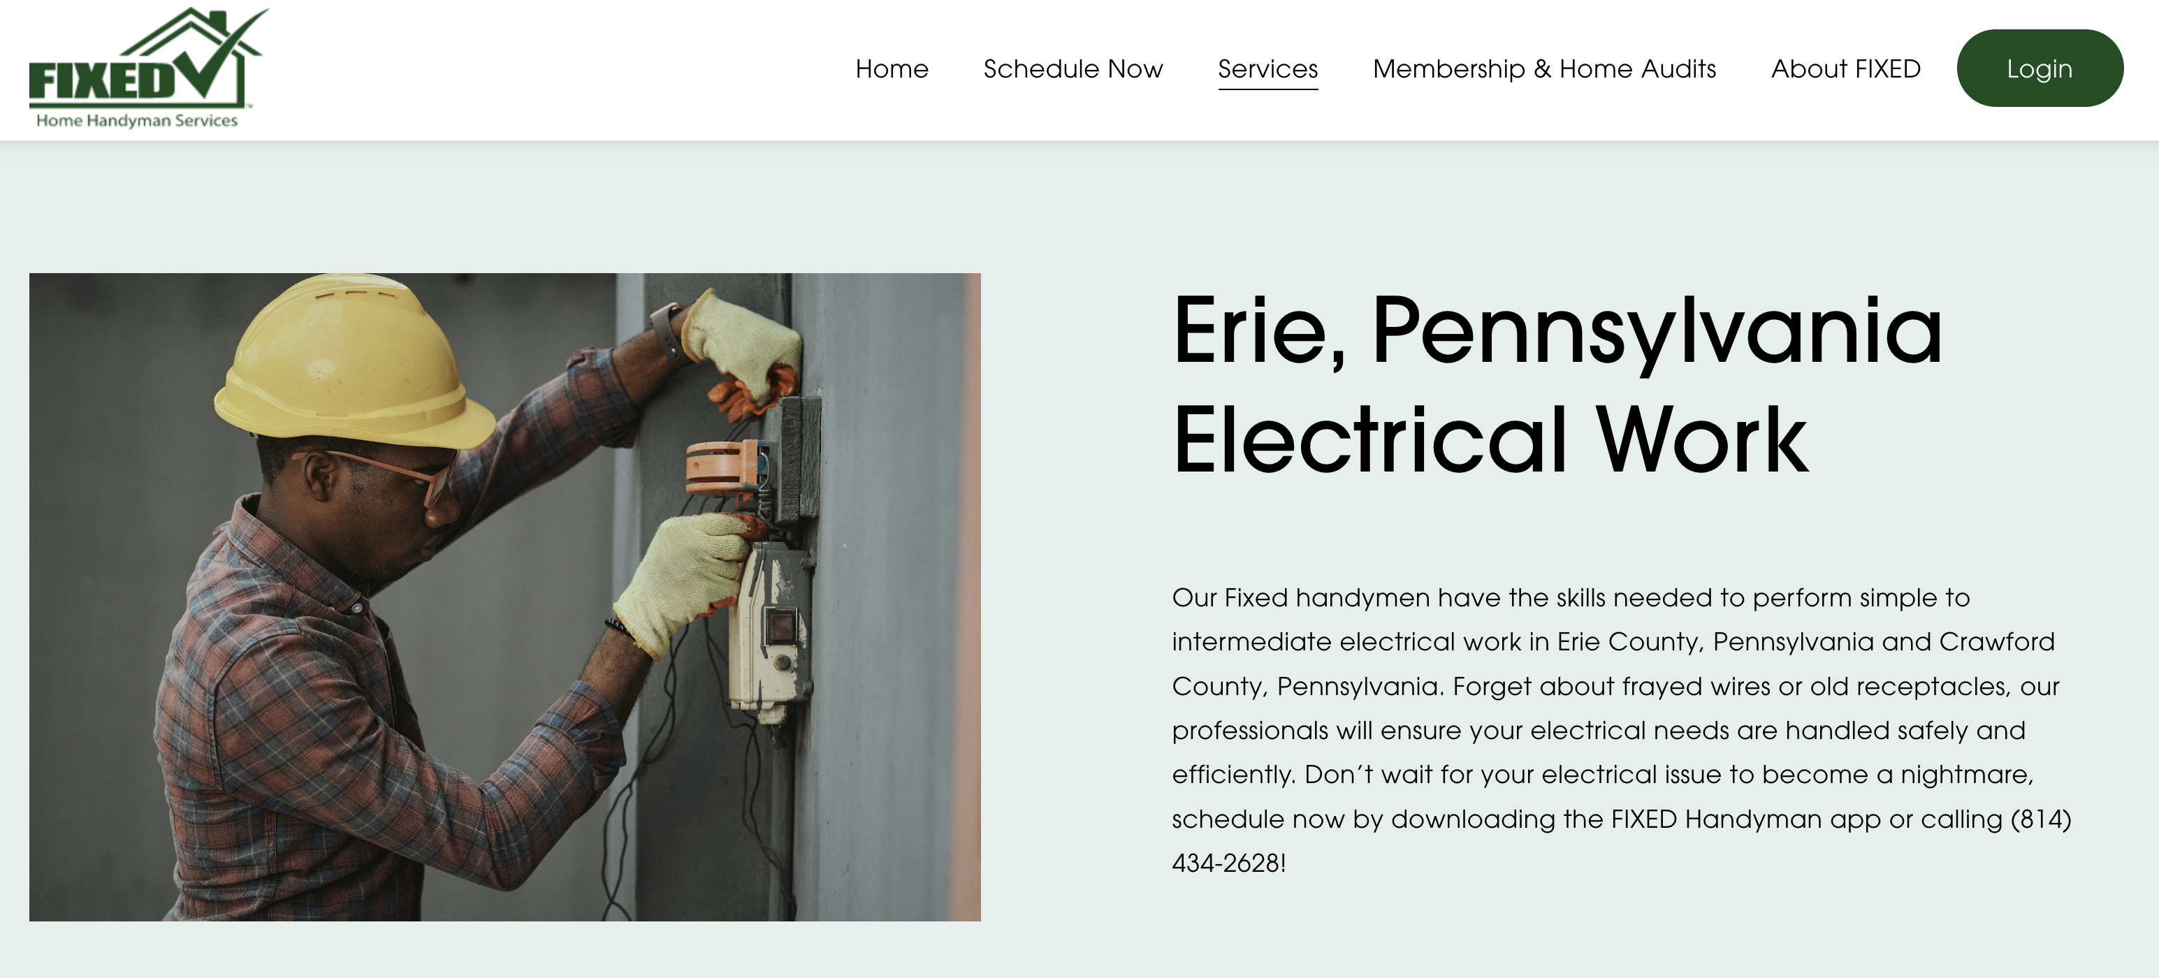
Additional Results/Outcomes
-
Quick client stories.
911 Vision Express:
— Edinboro-based business that received logo/branding in fall 2023; now back for website development & photography.
Fixed HHS:
— Website work helped them rank for new keywords like “erie pa electricians,” “plumber erie pa” and “smart home handyman.”
Whaling Marine Services:
— Website ranks first on terms like “Erie pa boat repair” and 2nd for “erie pa de-winterize boat.”
RESULTS/OUTCOMES

Slide 24
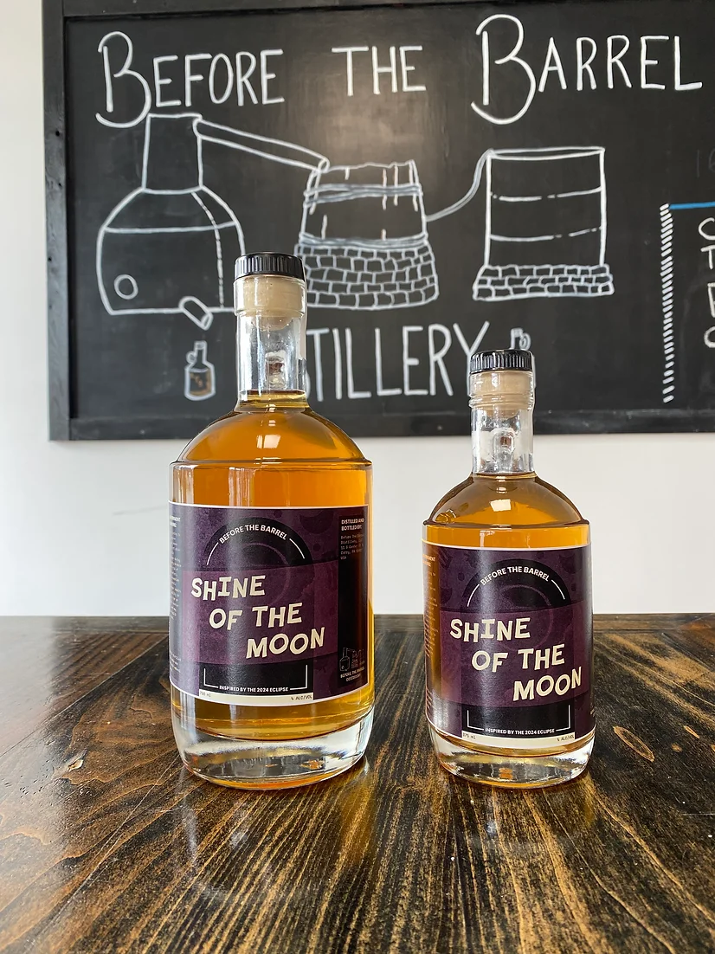
Additional Results/Outcomes
-
Quick client stories.
Before the Barrel Distillery (Corry):
— Ranked for 33 organic keywords at start of collaboration. After our work, now ranks for 145 keywords (339% increase). Also created an eclipse-themed label for them.
— Business moving to Erie and we’re helping with some branding elements.
ProDomeSeal:
— Multiple Beehives have worked with this client; most recently, PennWest Edinboro provided a new packaging design.
RESULTS/OUTCOMES

Slide 25
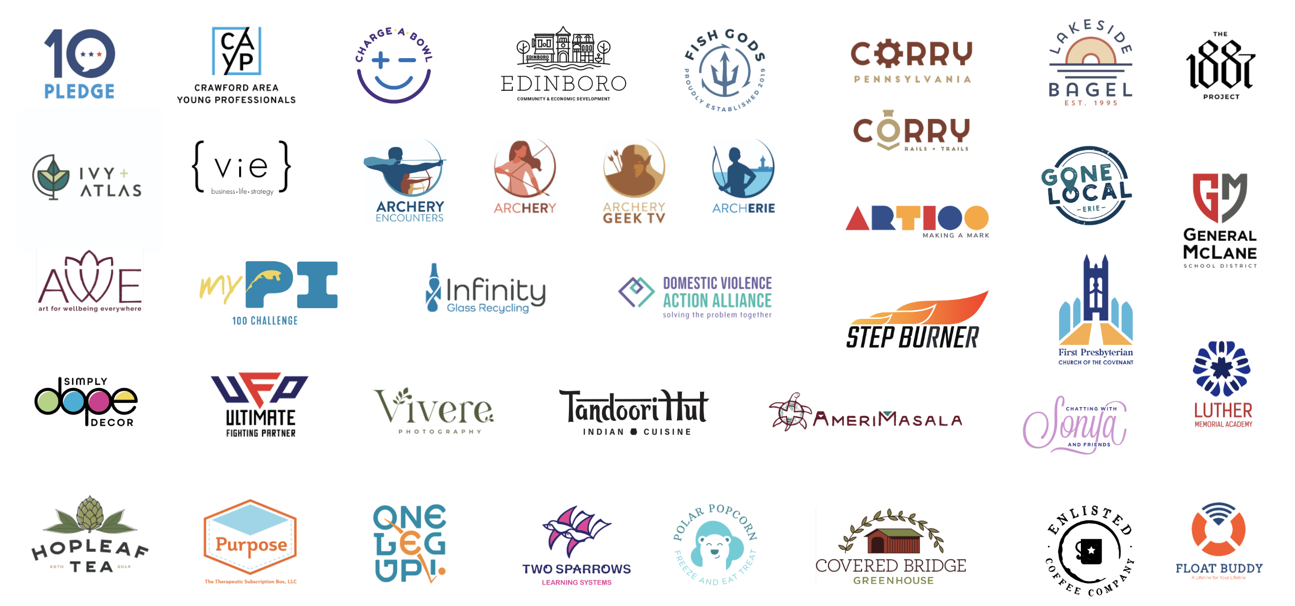
CLIENTS

Slide 26
Thank you
-
Please reach out with any further questions.
Beehive
Christopher Lantinen
Director
clantinen@pennwest.edu 814-732-1275
Edinboro University Foundation
Charles Scalise
Executive Director cscalise@eupfoundation.org 814-732-1669
PennWest Edinboro
Amanda Sissem
Associate Vice President, Alumni Engagement
asissem@pennwest.edu 814-732-1796
CONCLUSION

Slide 27
Build a Better Future, Transformative Grant Program Penn State Behrend Beehive
-
Nov. 21, 2024

Slide 28
Leveraging the impact and strength of Meehl Innovation Commons to drive regional branding and attract innovators.
-
GOALS:
Broaden community reach of the Beehive Network.
Build new collaborations that multiply efforts.
Prepare and engage the workforce.
Enable informed policy and legislation.
Amplify Project RESOLVE.
INTRODUCTION

Slide 29
Broaden community reach of the Beehive Network, Build New Collaborations
-
— Northeast Farm Heritage Days
— MCRC and USCRI (refugees.org) planning
— 4H Crafter Fair
— YBI, Beaver, Chautauqua
RESULTS/OUTCOMES

Slide 30
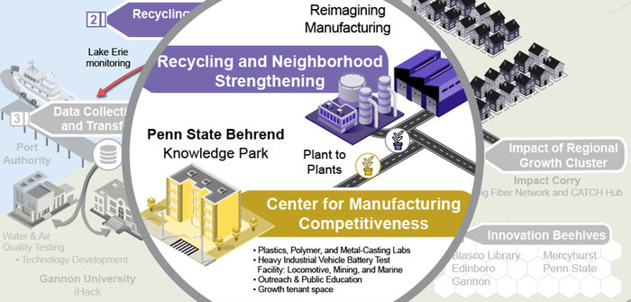
Prepare and engage the regional workforce, Enable informed Policy and Legislation.
-
— All-Access Career Fair (Both Spring and Fall)
- Attract new businesses.
- Beehive featured at the Fair. - Transportation from the city.
- Employ more Erieites.
— Shaping Tomorrow’s Manufacturing Legislative Workshop
- Focus group-based regional pilot in Spring.
- Including voices from plastics manufacturing, environmental researchers, and legislators.
- Success evaluation ↵
- Major legislative workshop in Fall.
RESULTS/OUTCOMES

Slide 31
This Project Since July 2024
3
Events Attended/Assisted
50
New Entrepreneurs Reached
(no prior contact)
RESOLVE Running Totals
18.5M
(4M in process)
RESOLVE Investments
4.9M
New Research Investments
NWPA Innovation Beehive Network — The Outcomes

Slide 32
How you can help!
-
— Get the word out.
— Encourage attendance, and connect relevant companies.
RESULTS/OUTCOMES

Slide 33
Thank you
-
Please reach out with any further questions.
James R. Meehl Innovation Commons
Jacob Marsh
Industry Relations Coordinator
jam522@psu.edu 814-602-9381 (c)
Project RESOLVE
Dr. Amy Bridger
Assistant Dean for Innovation and Corporate Strategy
aeb20@psu.edu
CONCLUSION

Slide 34
Build a Better Future, Transformative Grant Program NWPA Beehive
-
Nov. 21st, 2024

